Slide 1
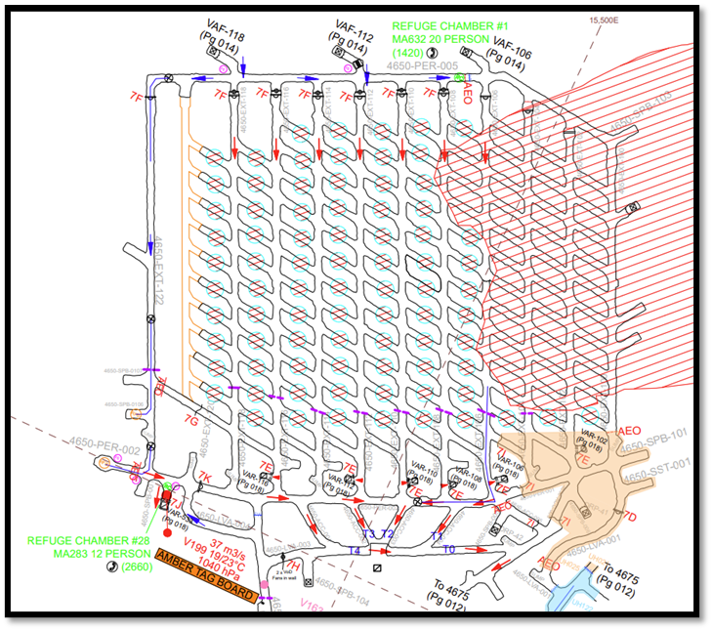
Possible upstream monitoring locations
Possible downstream monitoring locations
Example drives to monitor
D3 Kestrel
Gas detector
DPM Pump
Dust instrument (Rangers)
Flow measurement

Slide 2
Drives to monitor
D3 Kestrel
Gas detector
DPM Pump
Dust instrument (Rangers)
Flow measurement

Slide 3
Drives monitored
D3 Kestrel
Gas detector
DPM Pump
118-N
Dust instrument (Rangers)
Flow measurement
114-N
118-S
114-S
T0

Slide 4
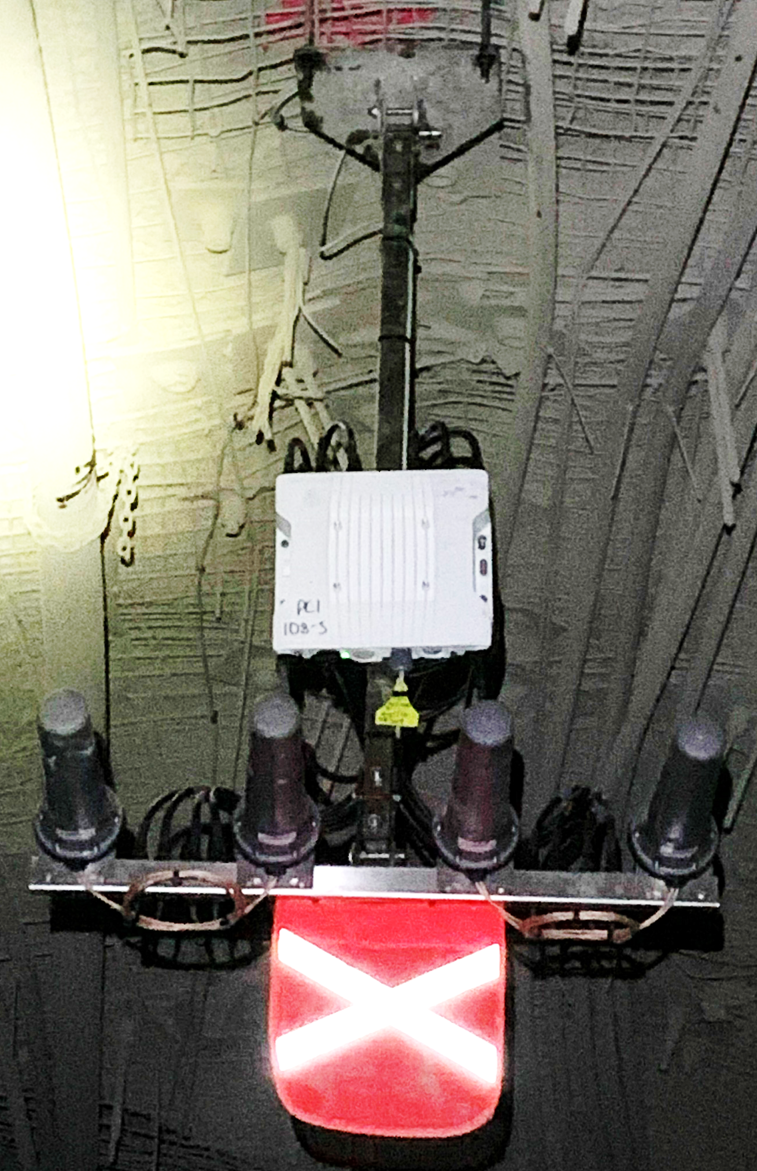

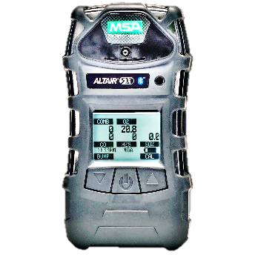
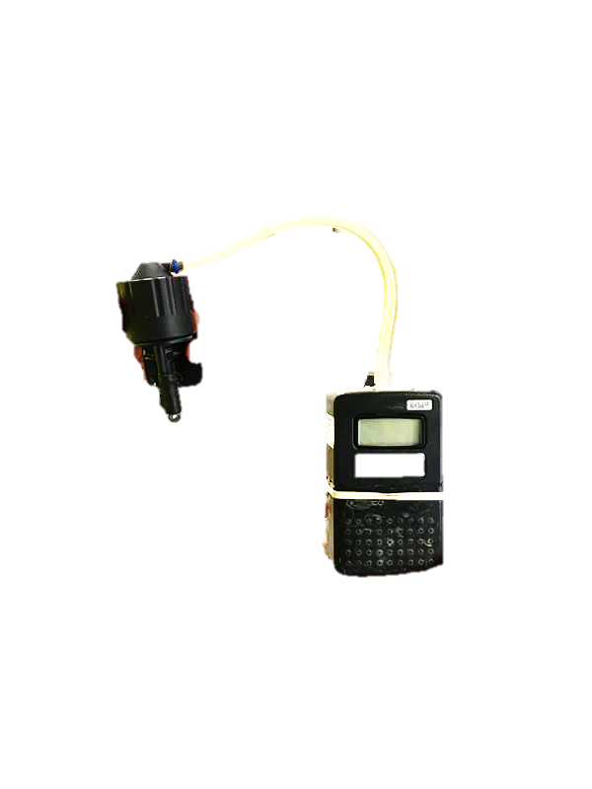
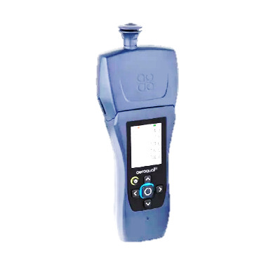
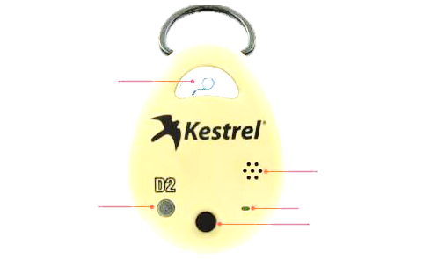
Gas detector
DPM pump
Dust instrument
D3 Kestrel

Slide 7
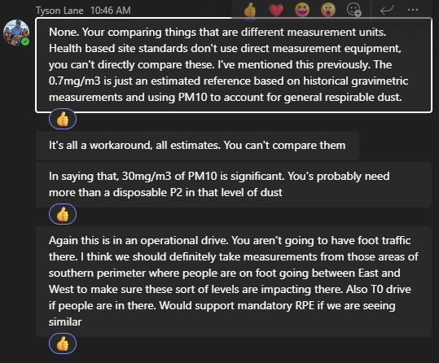

Slide 9
d
b
u
N
S

Slide 10
Drives to monitor
Gas detectors

Slide 11
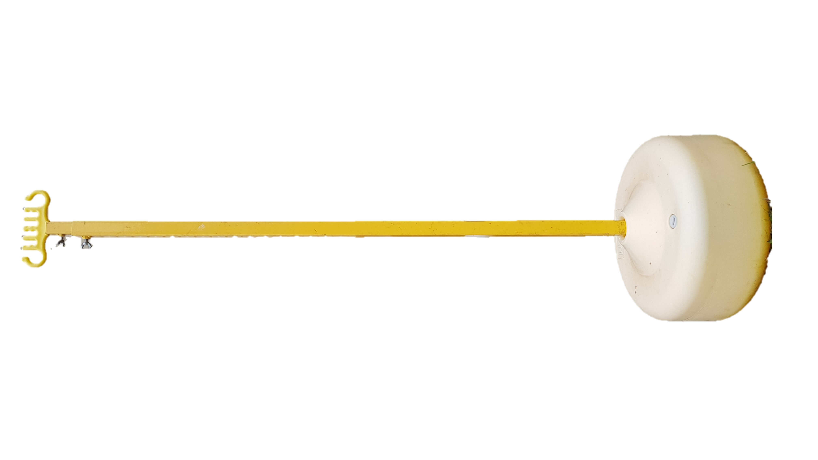
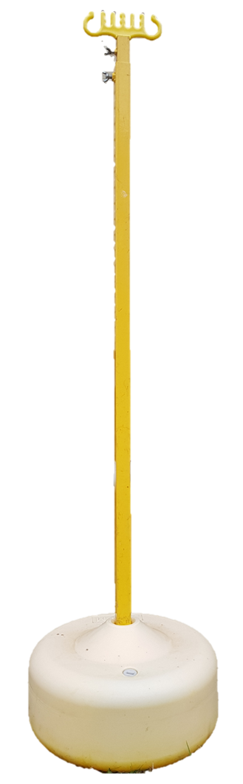
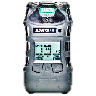
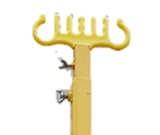
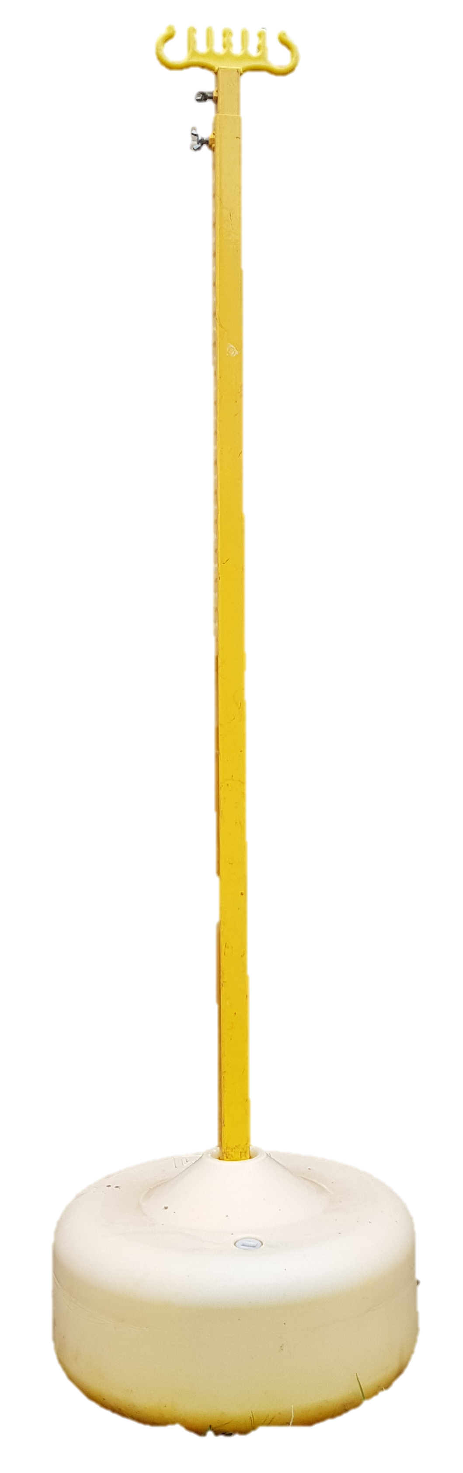

Slide 12
